Slide 1
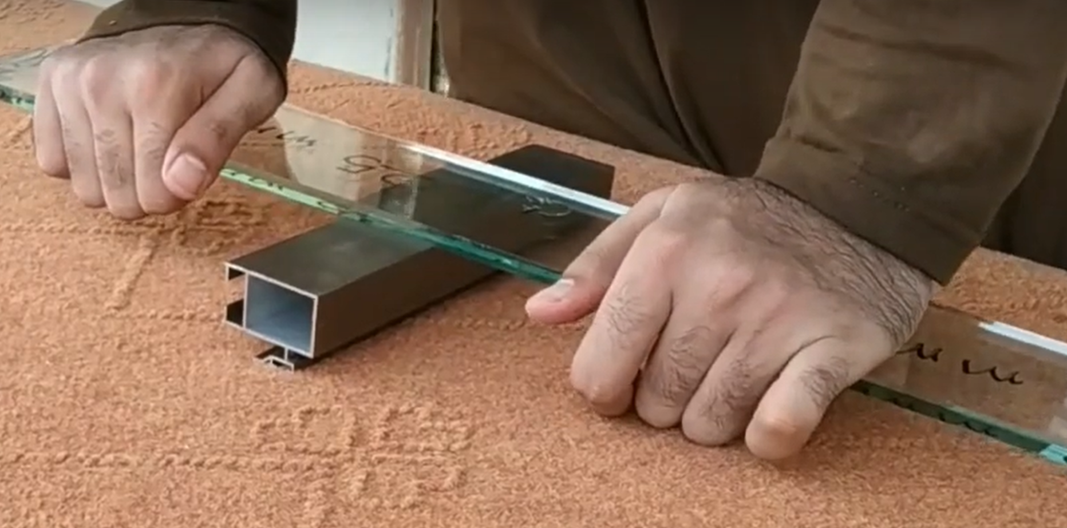

Cutting stock problem
Introduction
Mahyar Mohammadi
Bio-Inspired Algorithms
Prof.BabaAli

Slide 2
Table of contents
Contents
1
3
5
7
none metahuristic Algorithm
Some related works
Co-evolutionary
GA
Tabu
Search
Problem
Description
Varient of
CSP
Genetic
Algorithm
Simulated
Annealing
6
8
2
4

Slide 3
Problem
Description
If you have seen wide Paper or Fabric Rolls cut into smaller width rolls, or cutting of big metal rods.
You might have wondered:
How many ways are there to cut a big stock item into small pieces of required lengths?
The answer is: Too many ways!
Perhaps a better question is:
How to cut required small pieces from the stock item so that waste is minimum?
Another question you could ask:
How to cut the required small pieces from the stock item so that minimum possible stock items are used?

Slide 4
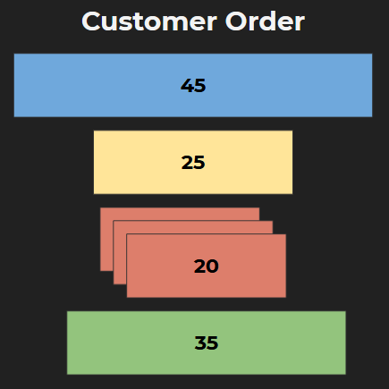

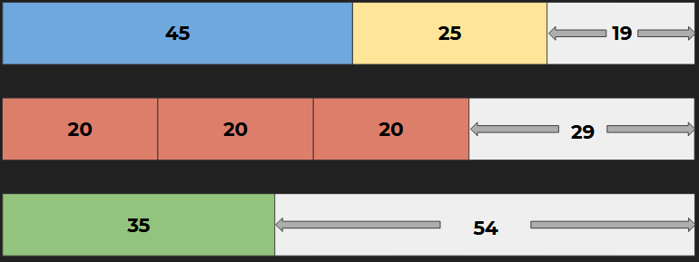
Problem
Description

Slide 5
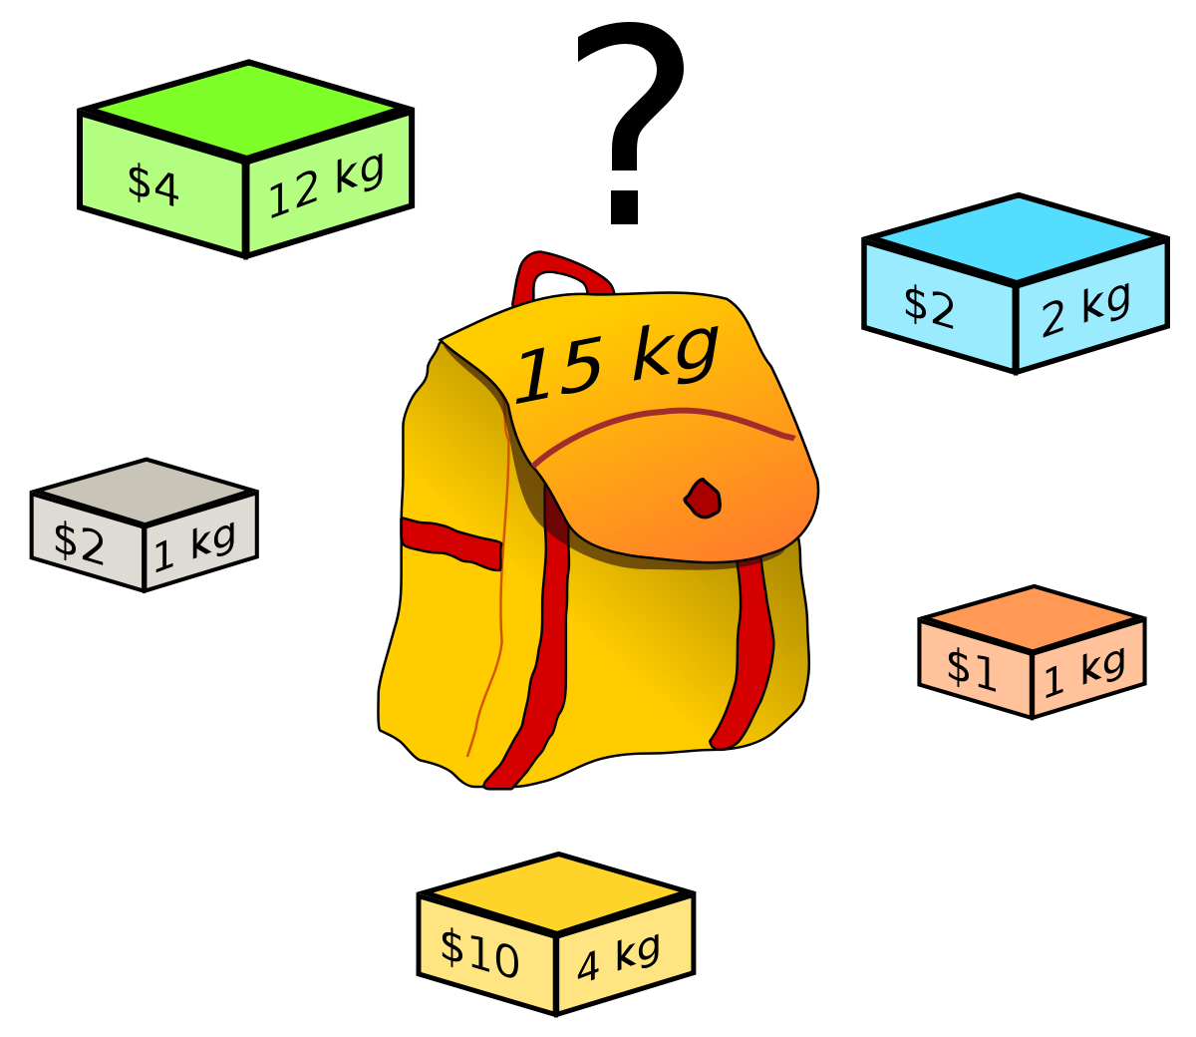
N-knapsack
Algorithm

Slide 6
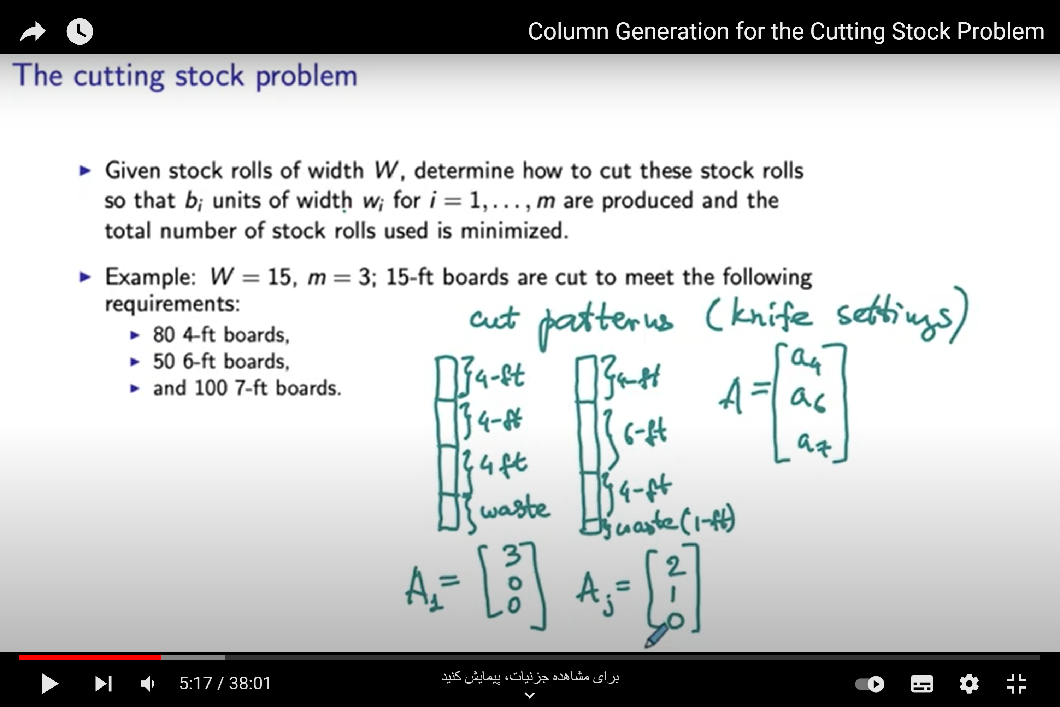
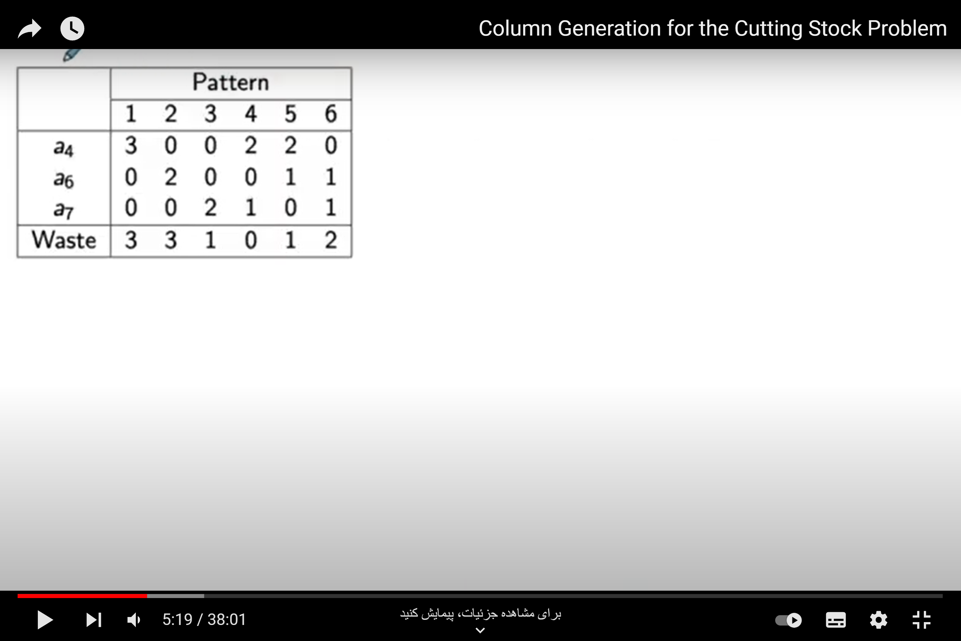

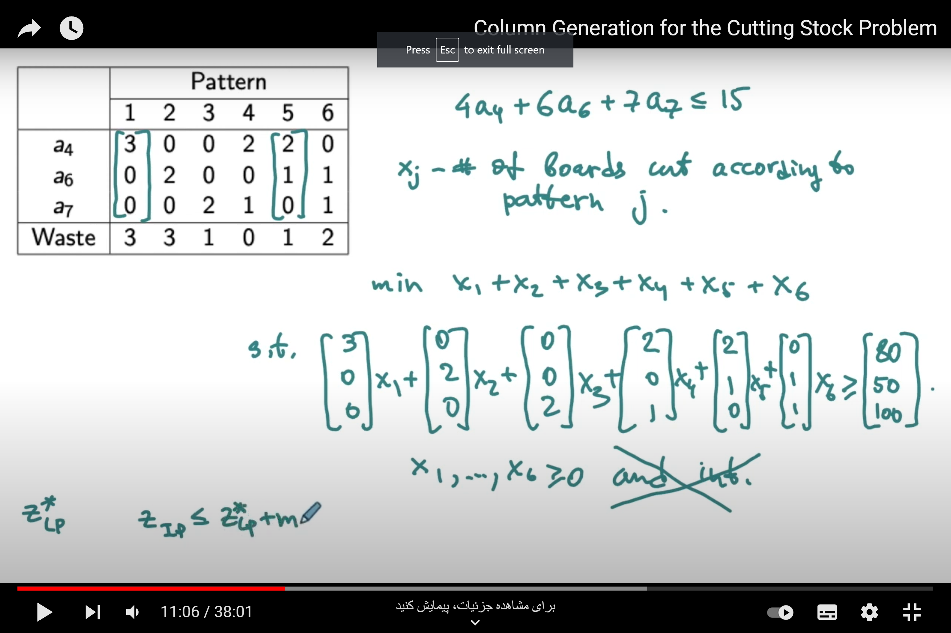
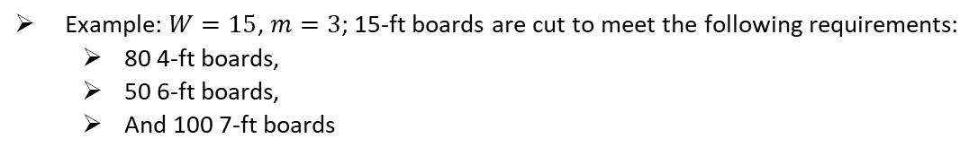
N-knapsack
Algorithm
Example: $W=15$, $m=3$; 15-ft boards are cut to meet the following requirements:
80 4-ft boards,
50 6-ft boards,
And 100 7-ft boards

Slide 7
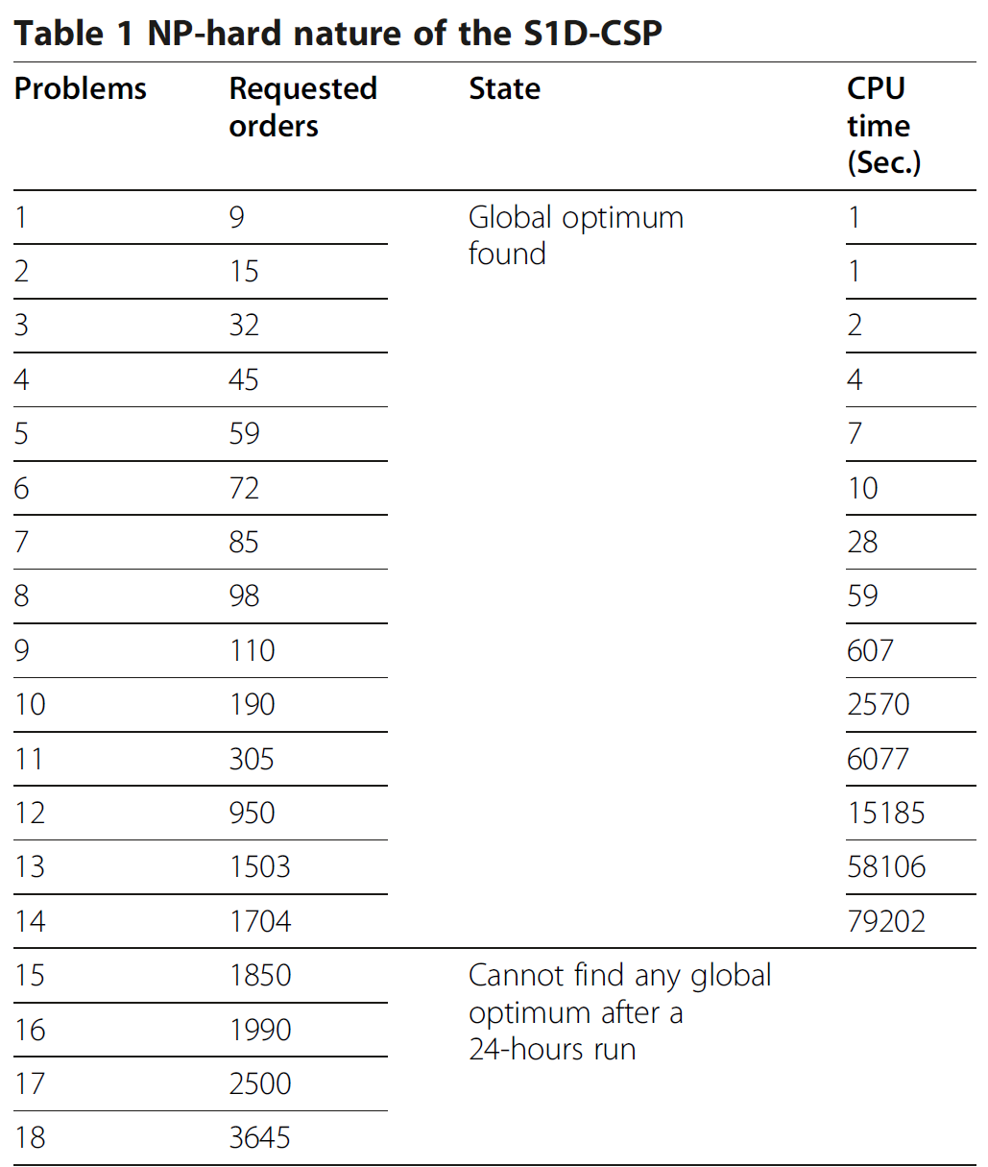
Algorithm
time

Slide 8
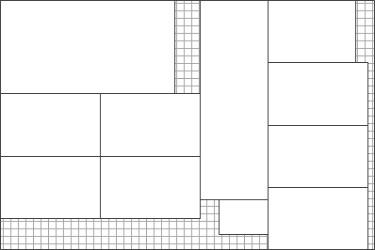
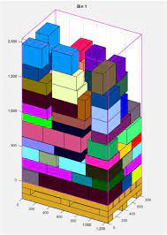
Varient of CSP
Cutting
Stock
problem
And More…

Slide 9
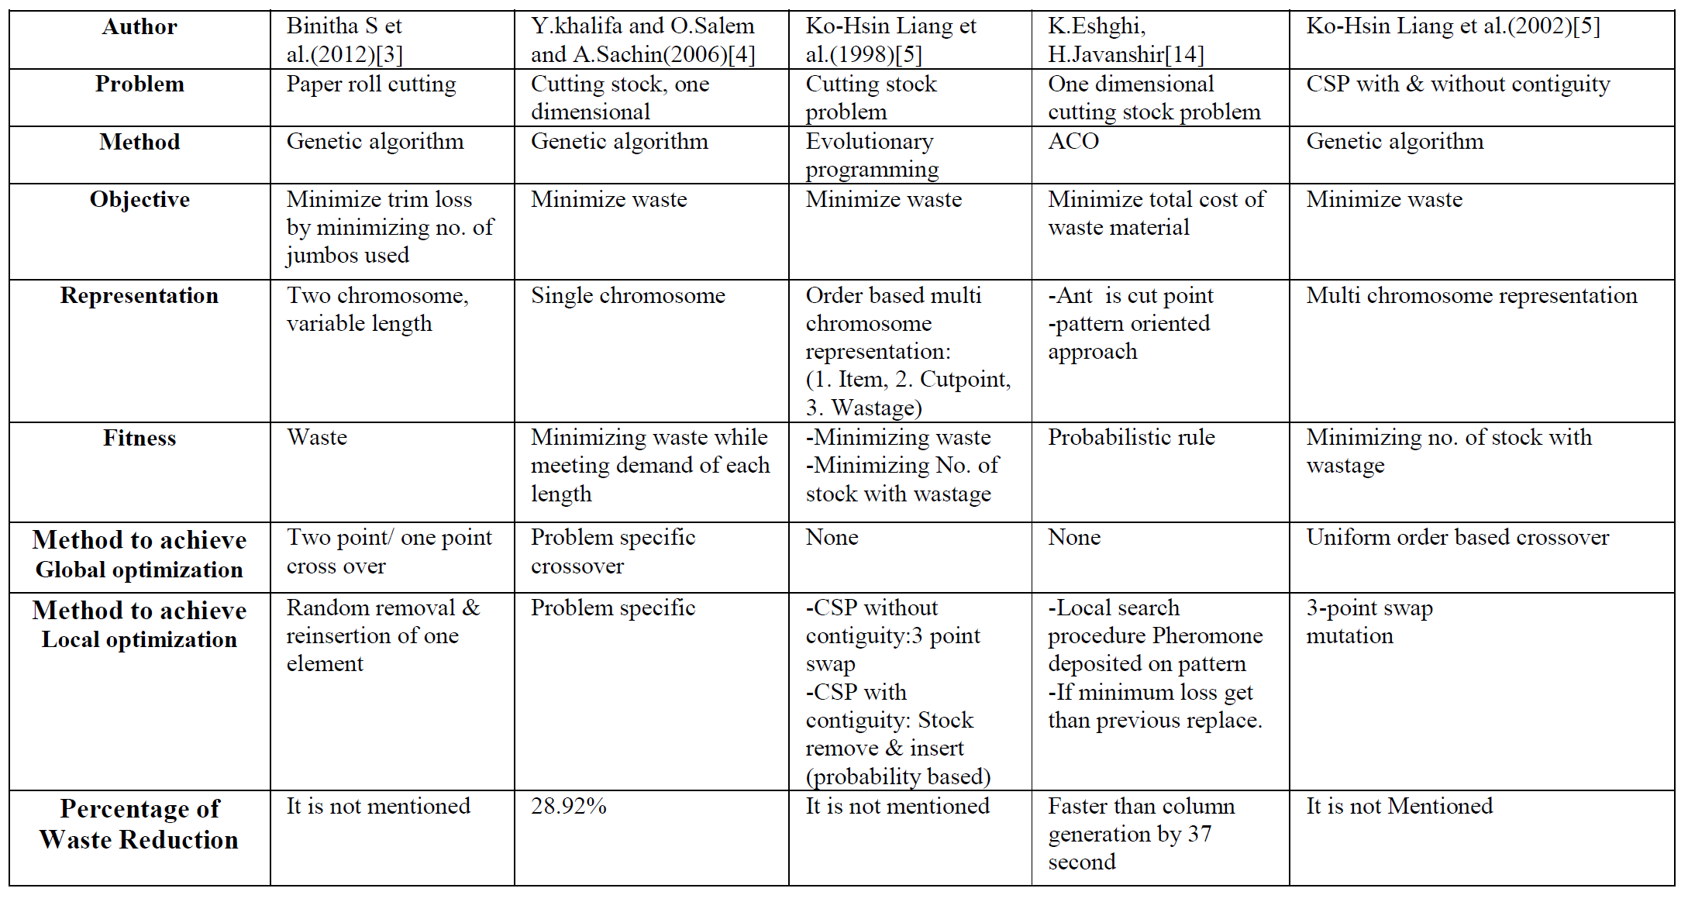
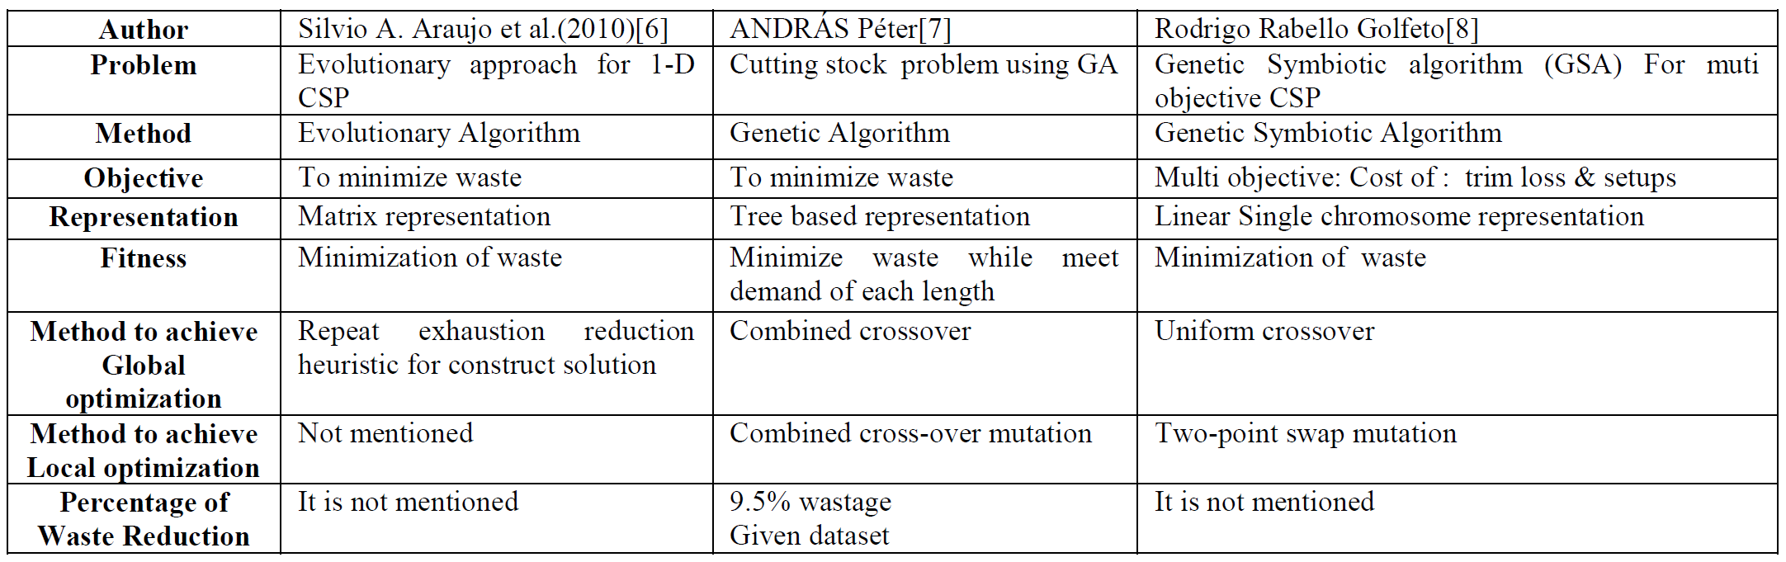
Matheuristic
Algorithm

Slide 10

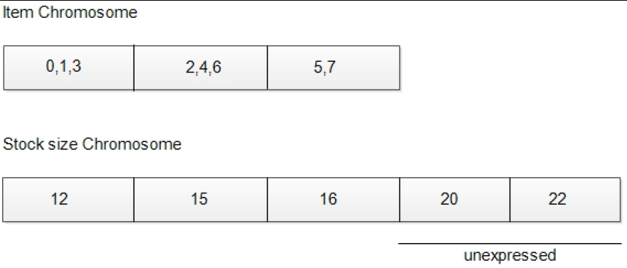
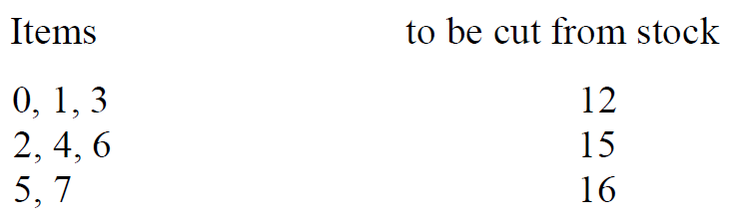
Genetic
Example:
Customer Requirement:
{5, 8, 7, 8, 10, 7}
Algorithm
Available stock size:
{20,10,15,10}
Advantage: it’s Simple
Single Chromosome Representation
Disadvantage: It’s take time to calculate the truthness of answer
Multi Chromosome Representation
Advantage: Fast
Disadvantage: apply crossover or mutaition disturb the group.(not feasible to cut group from stock) so the computational time of crossover and mutation is increased.

Slide 11
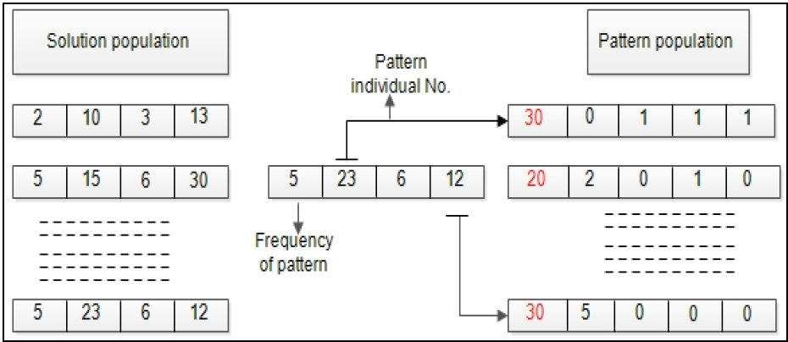
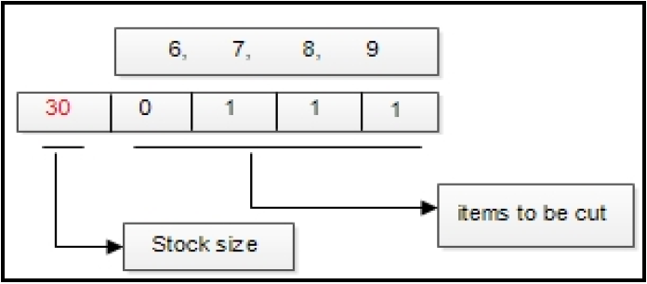
Co-evolutionary
Customer Requirement (item) : {6, 7, 8, 9}
GA

Slide 12
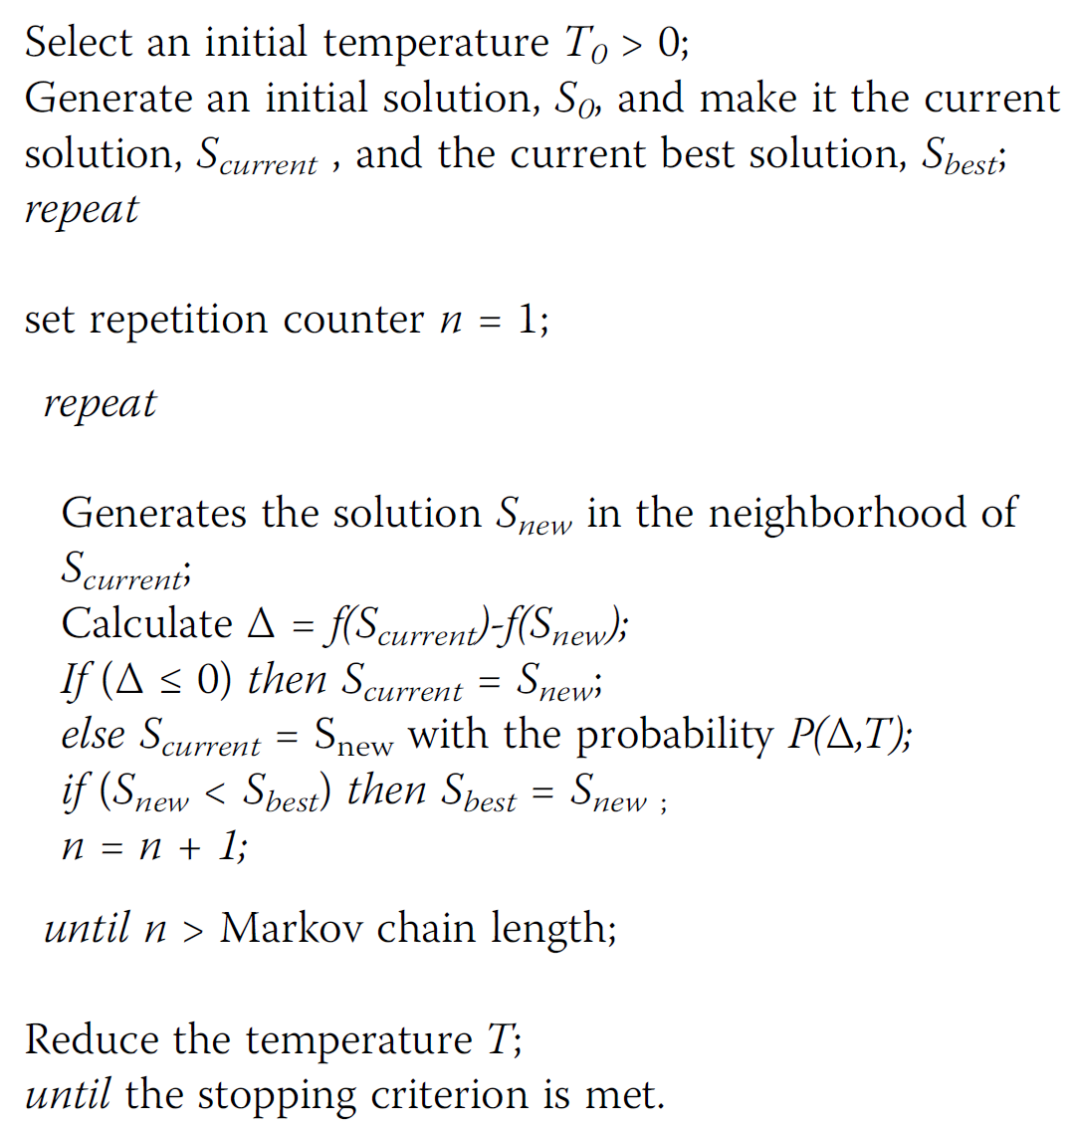
Simulated
Annealing
Marlov chain length: the number of
searched points in solution space at each temperature

Slide 13
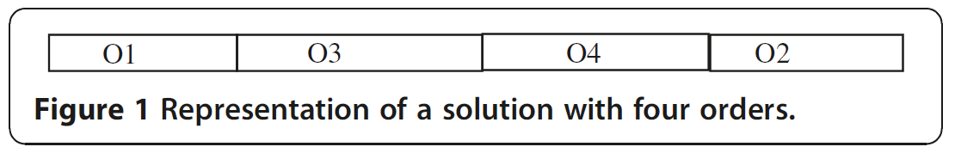
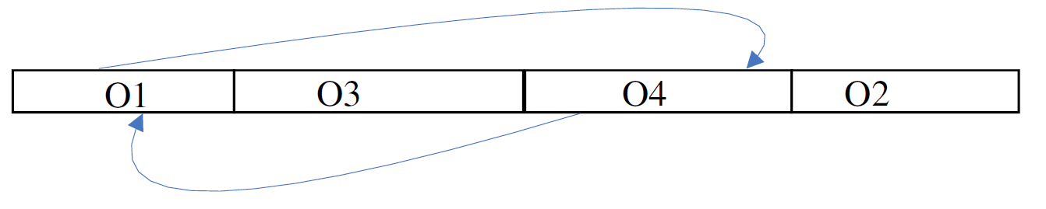
Simulated
Annealing
Solution: 1D array(permutation of orders)
Neighborhood: change place of 2 order in solution
Fitness function: less waste more point!
Temperature decreasing function:
Tk = αTk-1(0.85<α<0.95)
Markov chain length: depend on size of the order list

Slide 14
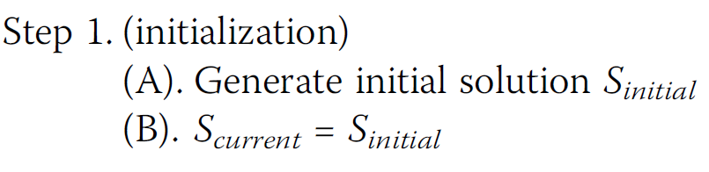
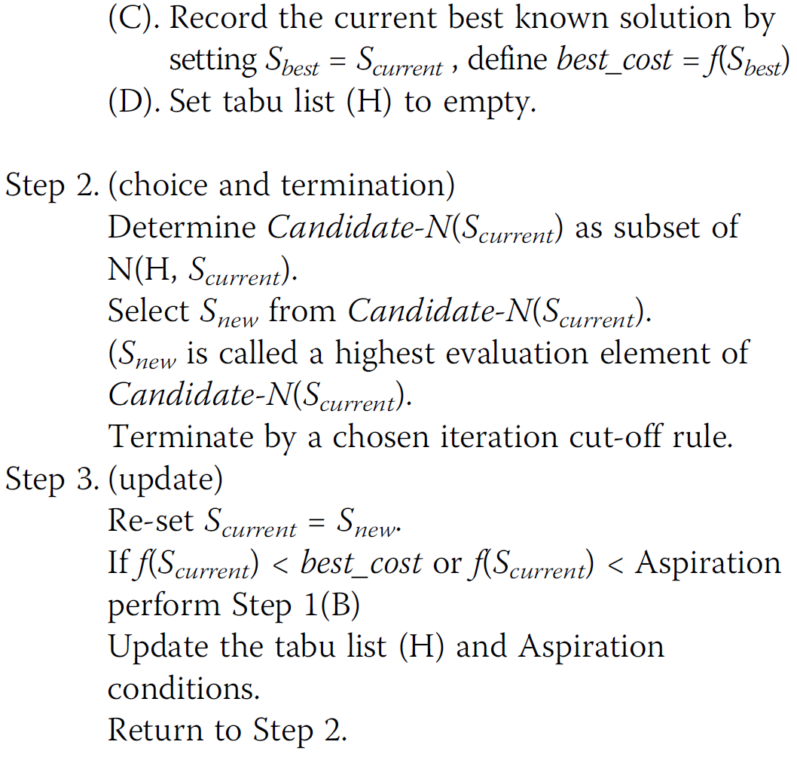
Tabu Search
Select some of tabu list
neighbor as tabu

Slide 15
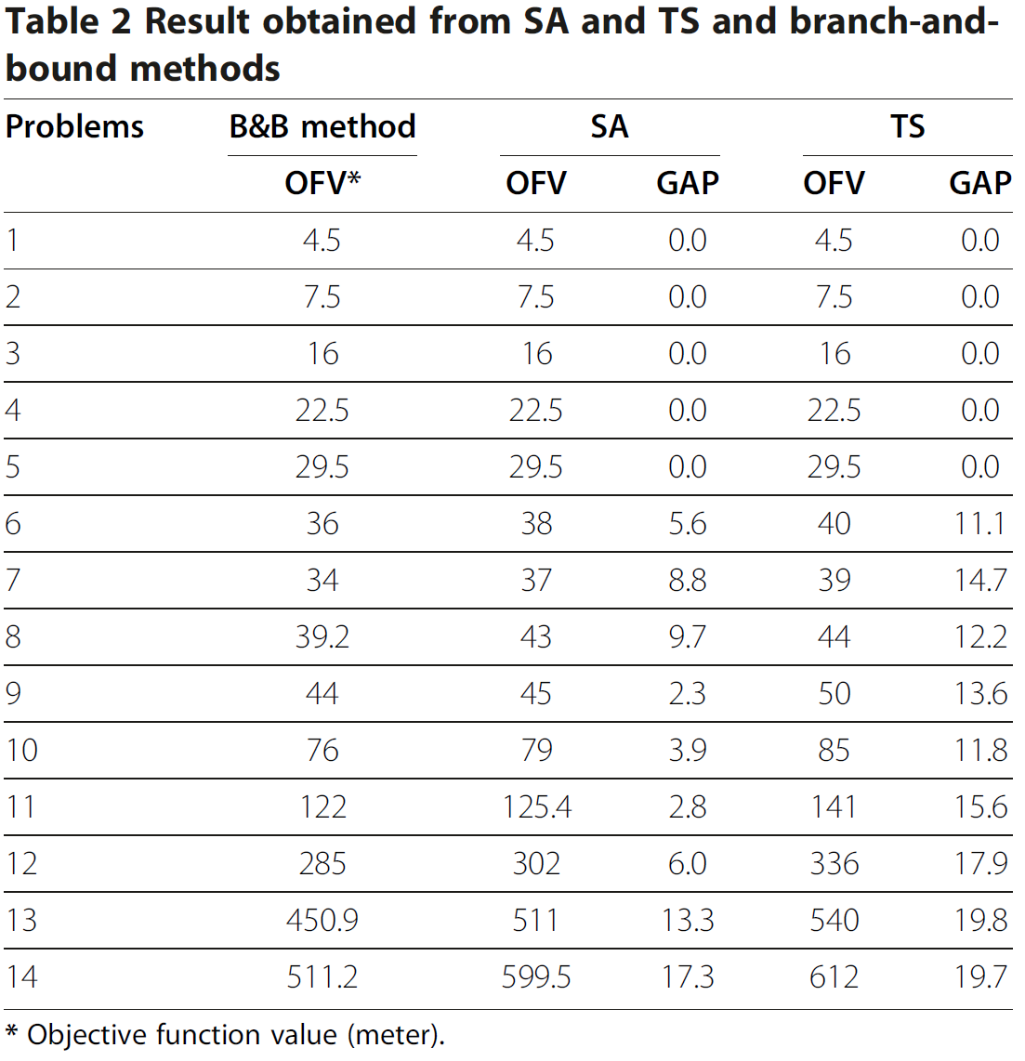
Compare

Slide 16
ALGORITHM FOR THE CUTTING STOCK PROBLEM WITH MULTIPLE RAWS AND LIMITED NUMBER OF CUTTING KNIVES
alternate.parts/cutting-stock-problem
Solving binary cutting stock with matheuristics using particle swarm optimization and simulated annealing
Cutting Stock Problem: A Survey of Evolutionary Computing Based Solution
Refrences
Solving an one-dimensional cutting stock problem by simulated annealing and tabu search

